Slide 1
The Modern Software Developer
CS146S
Stanford University, Fall 2026
Mihail Eric
themodernsoftware.dev

Slide 2
Logistics
Final project specifications out
  Allowed 1 additional team member (in addition to a swarm of coding agents)
Credits for different coding agent providers
  Claude
  Factory
  X.AI
  Devin
More details on OSS contributions next week
Final deadline is 9/27 for course applications
themodernsoftware.dev

Slide 3
The Anatomy of a Modern Coding Agent
themodernsoftware.dev
Notes:
Which brings us to this course…

Slide 4






Recap
themodernsoftware.dev
Notes:
User interacts with coding agent client (windsurf, cursor, claude code) and runs a loop with an underlying llm. Sometimes the llm issues tool calls which the client executes (off-LLM)

Slide 5
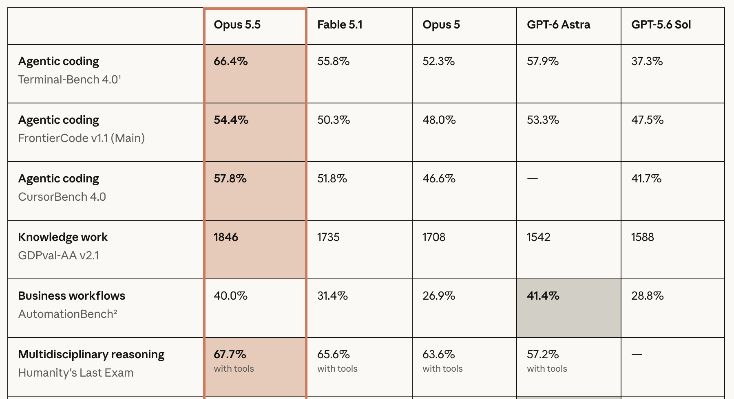
Enter a state-of-the-art coding agent
themodernsoftware.dev
Notes:
User interacts with coding agent client (windsurf, cursor, claude code) and runs a loop with an underlying llm. Sometimes the llm issues tool calls which the client executes (off-LLM)

Slide 6
Modern coding harnesses are more complex
Harness design is one of the most important problems in coding agents
Components
  System prompt
  Custom configuration files (AGENTS.md, etc)
  Tool list
  Plan mode
  Subagents
  Skills
  Hooks
  Compaction
themodernsoftware.dev
Notes:
Some of the components in an agent like claude

Slide 7
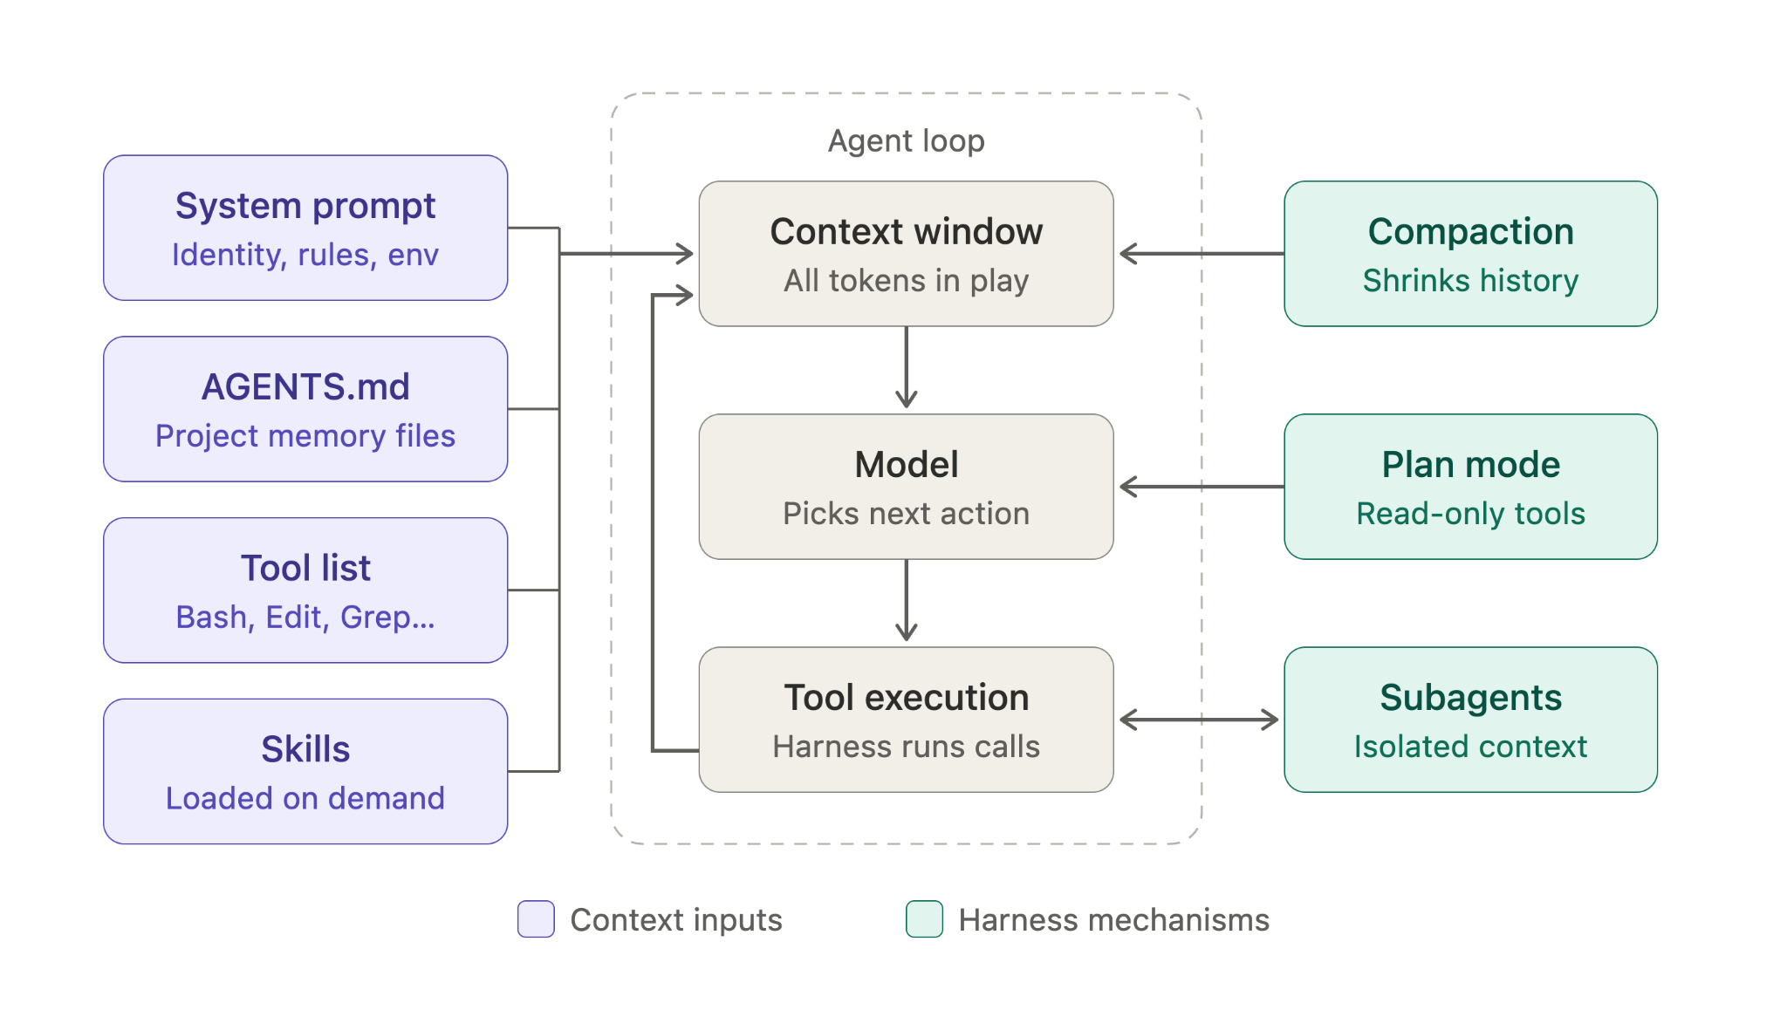
themodernsoftware.dev

Slide 8
Tool List
Lean but powerful capabilities across search, shell commands, agent tasks
~40 built-in tools in the case of Claude
MCP tools are also available and loaded into context
Description, names, full signature is a part of the prompt
themodernsoftware.dev

Slide 9
System Prompt
System level blueprint
Defines
  Harness / behaviors
  Guardrails
  Environment (ie what is the system, where are we)
themodernsoftware.dev

Slide 10
Agent Configuration Files
User-level agent customizations like CLAUDE.md/AGENTS.md
Take precedence over other commands
themodernsoftware.dev

Slide 11
Plan Mode
Explicit tool prompting agent to make a spec for a change
Can engage in further questioning with user to clarify requirements
themodernsoftware.dev

Slide 12
Skills
Describes a written procedure to be performed by agent
A prompt with tool calls and/or local script invocations
Can be invoked proactively or explicitly
themodernsoftware.dev

Slide 13
Subagents
Invoked via an explicit tool call
Fresh context within session with custom system prompt
Allows for parallelization (though token costs go up)
Final result passed back to parent
themodernsoftware.dev

Slide 14
Hooks
Prompts or snippets of code that are inserted at different points in the harness lifecycle
Especially interesting if some pre/post-processing needs to get done
We’ll discuss best practices later
themodernsoftware.dev

Slide 15
Compaction
Create consolidated summary of key points in agent run when context is almost exceeded
Replace existing history with summary
Triggered manually or automatically
Can be lossy so you may want to adapt your own
themodernsoftware.dev

Slide 16
Principles of Effective Harnesses
Simplicity
  Fewer, more powerful tools are preferred (sql, bash, etc)
Mind the context window – avoid the dumb zone so be careful of tool bloat
  More on optimal context engineering later
Prompt contents and lengths will evolve – make it easy to adapt them
themodernsoftware.dev

Slide 17
Questions?
themodernsoftware.dev

